Slide 1
Soils and their Significance
Part 2

Slide 2
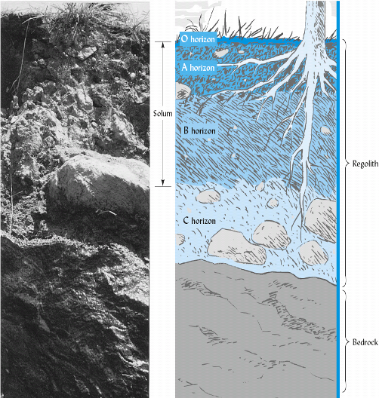
The soil profile and layers
“A soil is the product of both destructive and creative (synthetic) processes”
Soil horizons are the result of the synthetic processes

Slide 3
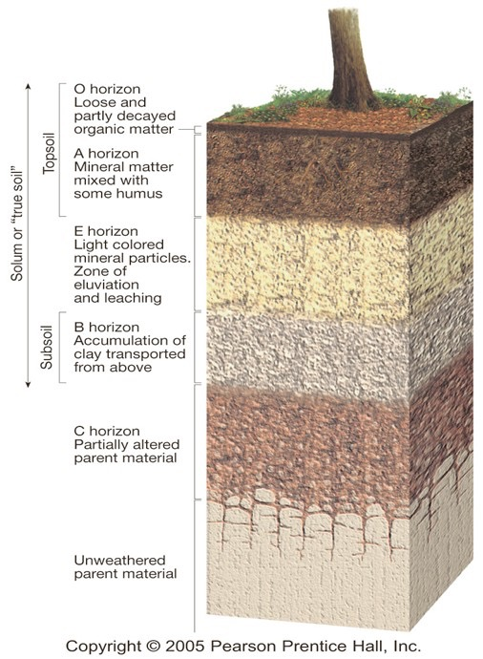
The soil layers or horizons
Least weathered------------------Most weathered
How is this layer weathered?

Slide 4
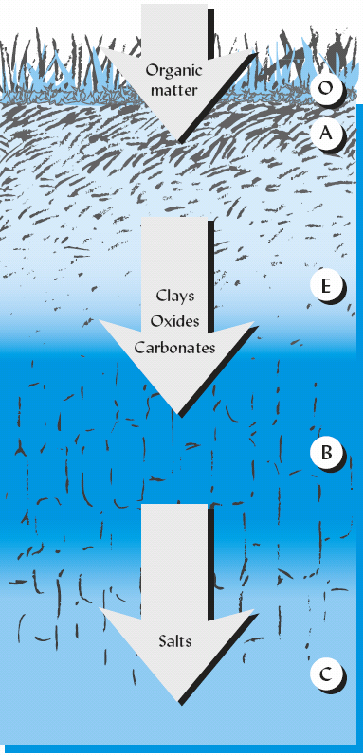
How horizons differentiate
organic matter is continually added to the upper profile
Leached E horizon associated with forests and high rainfall
Other materials are translocated to deeper zones
Soluble salts carried through profile with sufficient rainfall
Many soils lack one or more of these horizons

Slide 6
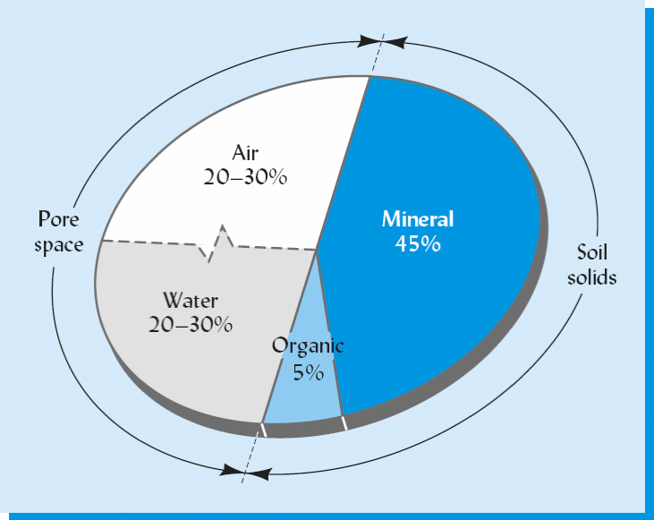
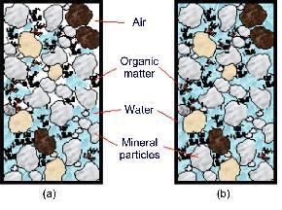
Soil as Air, Minerals, Water, and Life
Is soil a solid material??
No, about ½ is solid material and ½ is pore space

Slide 7
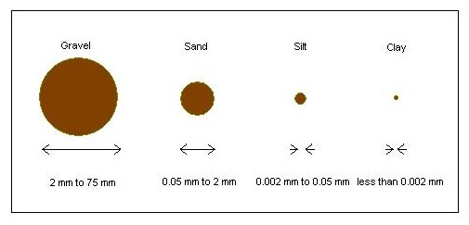
The mineral constituents of soil
Largest soil particles are stones, gravel, coarse sands- generally consisting of several mineral types
The fine mineral fraction is composed of soil particles of three distinct sizes
Smallest particles (<0.001 mm) have colloidal properties

Slide 8
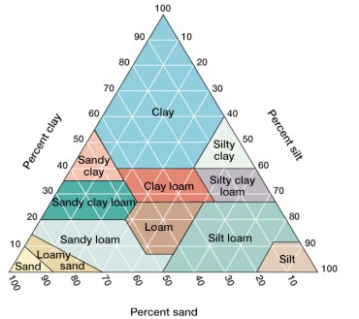
Soil texture
Texture has a profound influence on many soil properties and
affects suitability of a soil for a specific use

Slide 9
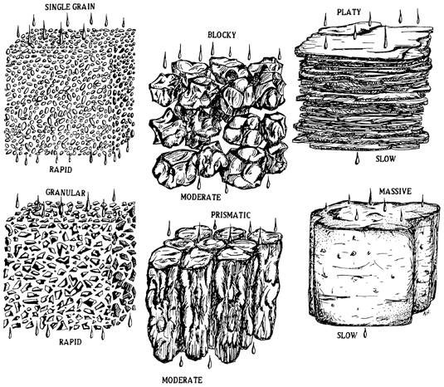
Soil structure- sand, silt, and clay are the building blocks from which soil is constructed
Although can be separate, the fine mineral fraction is
often associated together in aggregates as shown above

Slide 10
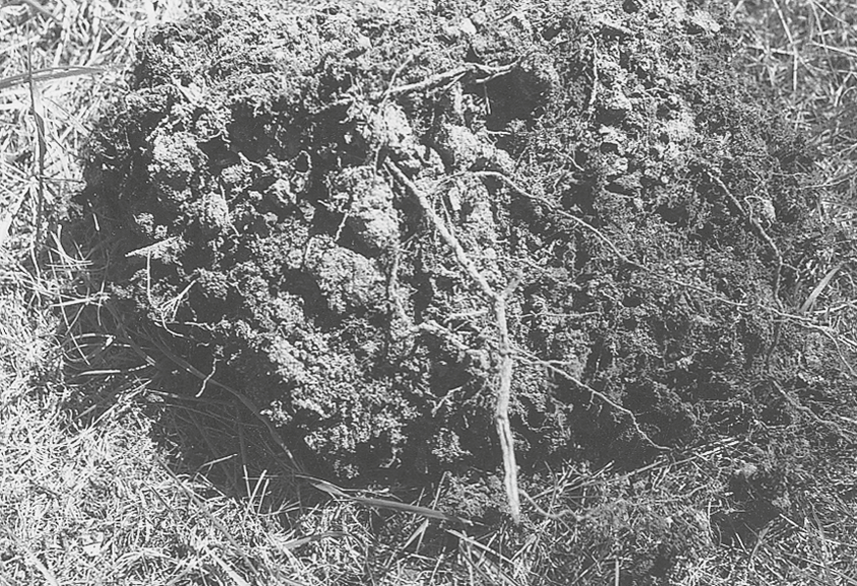
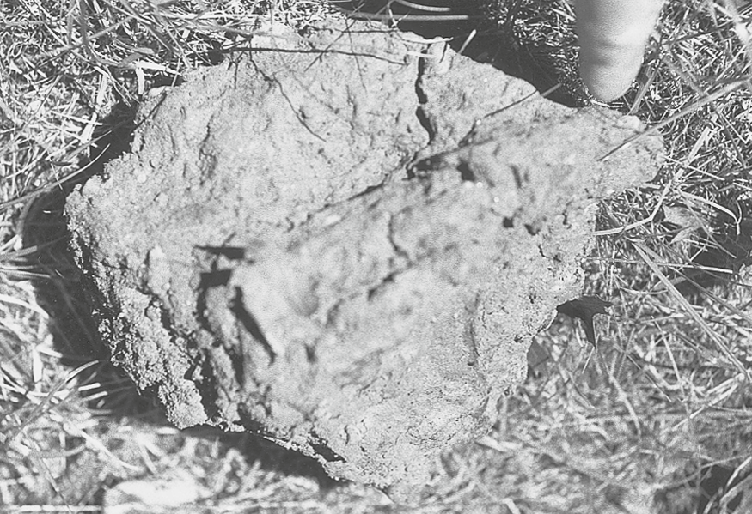
Soil Organic Matter (SOM) in soils
High OM favors optimal
plant and microbial growth
Low OM, in combo with high silt and clay, not optimal
New additions of residues are necessary to replenish the loss of OM as CO₂ is produced through microbial respiration

Slide 11
SOM in soils, cont.
SOM enhances soil structure by binding mineral particles into a granular structure typical of loose, easily managed conditions
The glue-like substances exuded by soil organisms and plant roots are responsible for stabilizing aggregates
SOM increases a soil’s ability to hold water and the portion of that water available to plants
SOM is the major source of P and S, as well as the primary source of N for most plants
Humus is the colloidal fraction of SOM

Slide 12
SOM and carbon sequestration
More carbon is stored in the world’s soils than in the world’s plant biomass and atmosphere combined!
Where do you think all this C comes from???
SOM is the main source of carbon and energy to soil organisms (it’s their food!)

Slide 13
Soil water is a dynamic solution
Soil water referred to as soil solution b/c contains hundreds of dissolved organic and inorganic substances largely released by the soil colloids
As plants grow, their roots take up soil solution from largest pores first, and as these pores are then filled with air, more water moves into these pores from smaller pores
This movement happens until remaining water is too tightly held to smallest pores for plants to “pull” it away

Slide 14
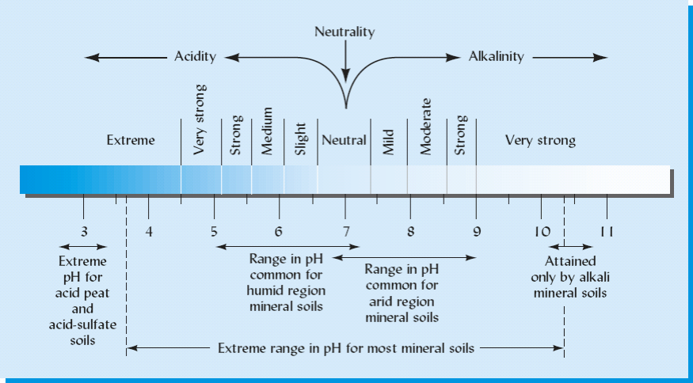
Soil solution pH measures degree of soil acidity or alkalinity

Slide 15
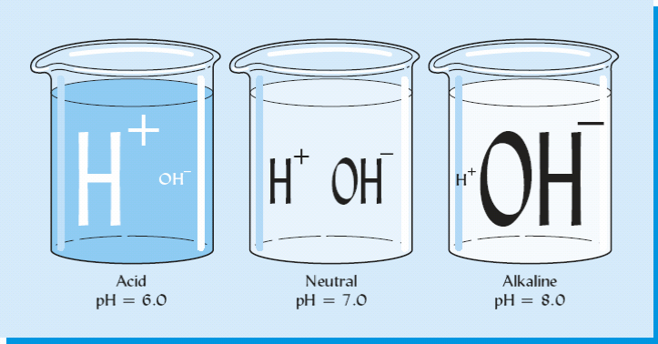
Picturing soil solution pH
More hydrogen ions <------------------------------------------> more hydroxyl ions

Slide 16
Soil Air - represents a changing mixture of gases
Soil air content is inversely related to water content (b/c they both occupy the same space)
What is this space called??

Slide 17
The four soil components interact to supply plant nutrients
What are the four components discussed?

Slide 18
Essential Element Availability
Perhaps the most important process is the provision of essential mineral elements to plants.
Plants absorb essential nutrients, along with water, directly from one of these components: the soil solution.
-
-
As plants deplete nutrients from the soil solution,
the solution is replenished due to exchangeable ions being adsorbed onto colloids

Slide 19
Supplying plant nutrients, cont.
Nutrient ions are also released into soil solution as soil microbes decompose organic matter
Plant roots can readily absorb all of these nutrients as long as sufficient O₂ is present in the soil air to support root metabolism

Slide 20
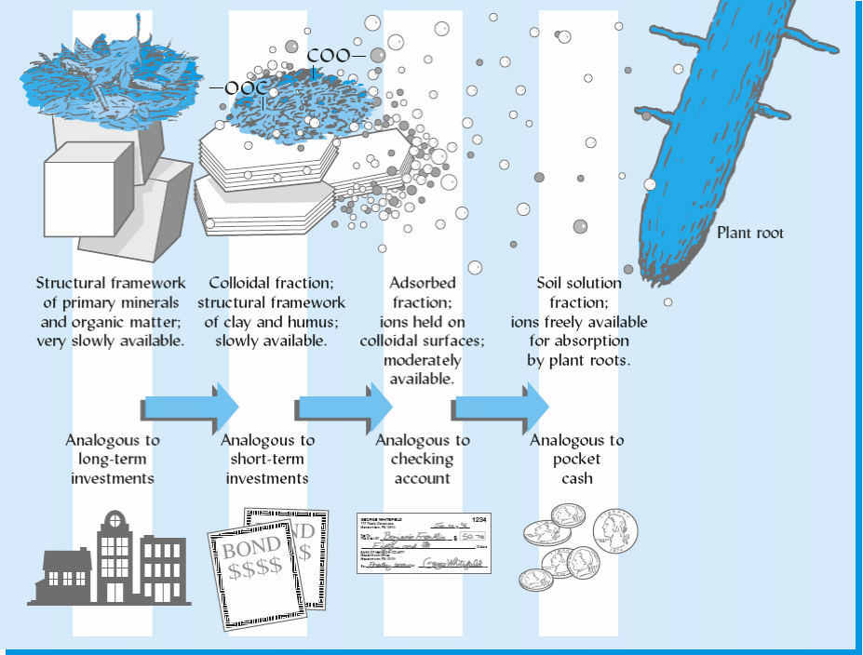
Vast supply of nutrients is held by minerals and SOM
Nutrient elements exist in soils in varying degrees of accessibility to plant roots,
analogous to financial assets varying in degree of liquidity

Slide 21
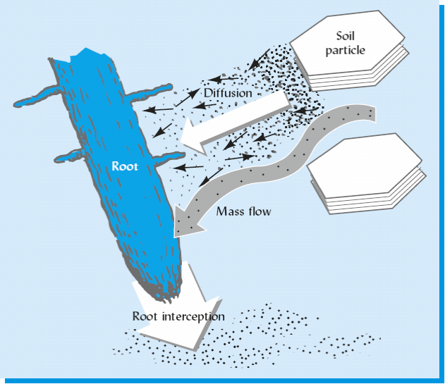
Nutrient uptake by plant roots- a nutrient element must be in a soluble form and must be located at the root surface
The particular nutrient determines which of the three uptake mechanisms
is most important

Slide 22
In Conclusion
Soils perform six broad ecological functions:
1) medium for plant growth,
2) regulate water supplies,
3) modify the atmosphere,
4) recycle raw materials and waste products,
5) provide habitat for many kinds of organisms, and
6) serve as a major engineering medium for human-built structures.
Soil is thus a major ecosystem in its own right!

